Slide 1
Welcome
Nalini Pather
and Heidi Waldron

Slide 2
Acknowledgement of Country
ANZAHPE acknowledges and pays respect to the Traditional Owners, Custodians and Knowledge-holders of the lands and waters across Australia on which our members live and work, and to their Elders, past, present and future.
ANZAHPE acknowledges Māori as tangata whenua and Te Tiriti o Waitangi partners in Aotearoa New Zealand.

Slide 3
AIPPEN IPE Session 1: ‘How to get ahead in publishing on all things interprofessional’
Professor Jill Thistlethwaite,
University of Technology Sydney

Slide 4
Please ask questions at any time – in the chat

Slide 5
Outline
Research or evaluation?
Choosing a journal
What makes a ‘good’ paper
Interprofessional research & evaluation: what does the field need (& editors want)

Slide 6
What is Educational Research?
Original work that adds to understanding about learning and teaching in the health and social care professions education.
Findings must be applicable outside the study context. Enough information is provided to tell the reader if the findings are applicable elsewhere.
Rigour vs Novelty. Less innovation means more rigour (e.g. replication study) and vice versa (e.g. pilot study)
Projects which are NOT research:
Routine quality assurance and evaluation
Results of assessments
Educational needs assessment showing lack of knowledge
BMC Medical Education Section Editors, February 2017

Slide 7
Evaluation is not Research
EVALUATION:
HOWEVER more likely to be of interest if:
Aims to collect information to improve a program
Specific findings only apply to one setting
Generally not publishable in research journals
Do still need to consider ethical approval & consent to publish
Innovative intervention
High level evaluation method
Includes process/realist or other theoretical evaluation
Acknowledges limitations

Slide 8
Choosing a journal
Read/browse a selection of journals – what’s the flavour?
Review for journals
Consider what type of article you plan to publish/what each journal publishes
Impact factor?
Author guidelines
Website
Acceptance/rejection rates
‘Pay to publish’ or ‘free’?
Type of review process
Time to decision
Time to being online

Slide 9
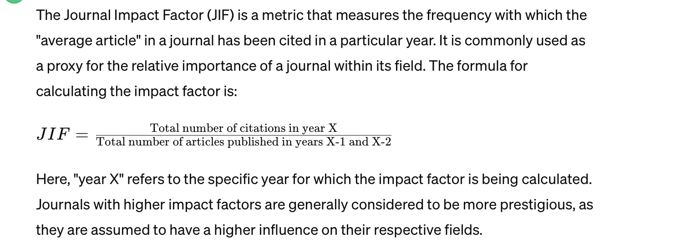
Academic Medicine 8.034
Medical Education 7.1
Lancet 168.9!

Slide 10
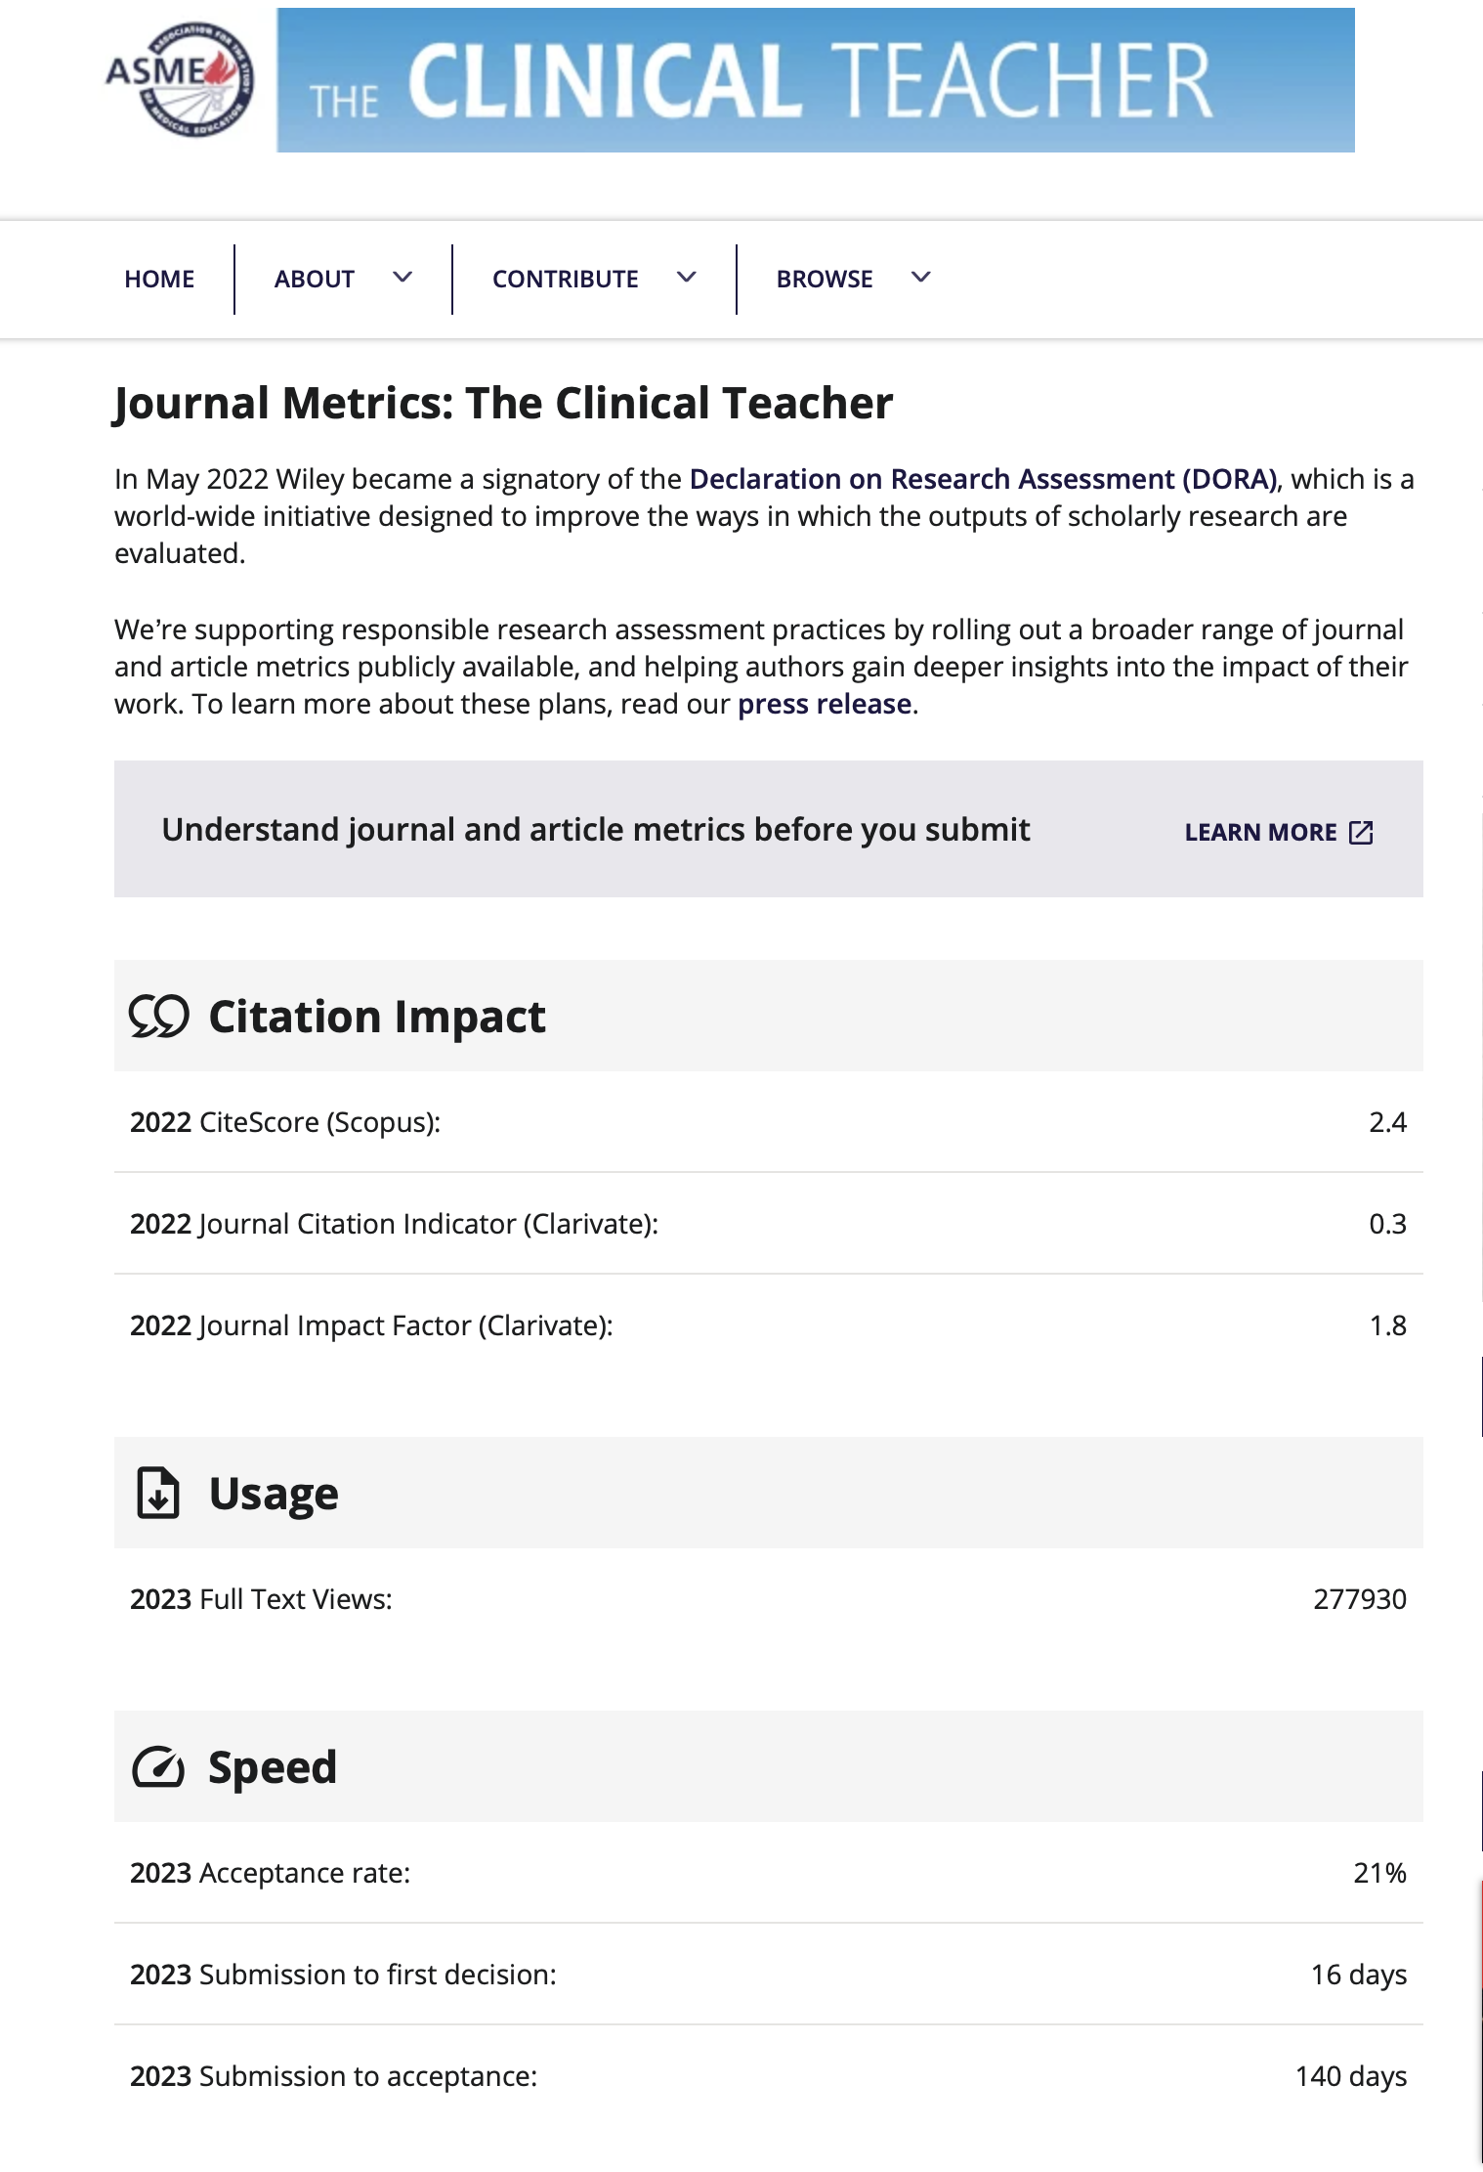
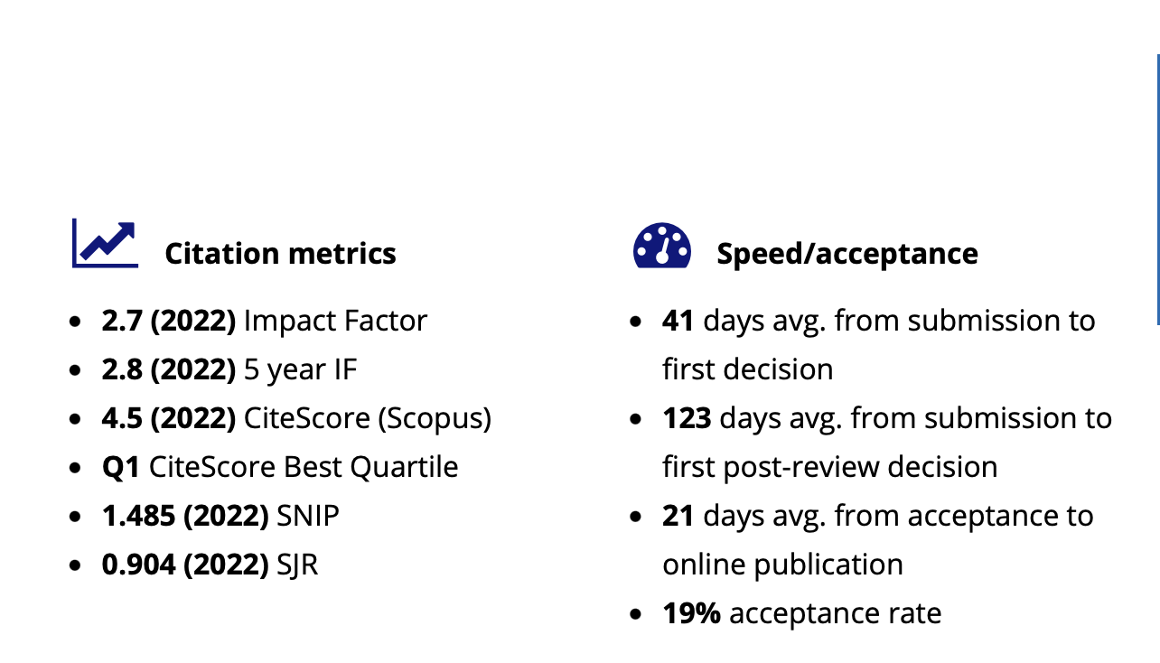

Slide 12
Types of articles
Research article
Program evaluation
Description of an innovation +/- evaluation
Argument for a novel curriculum/pedagogical approach/theoretical argument
Reflective essay/perspective?
Short report
Letter
Editorial (usually commissioned)

Slide 13
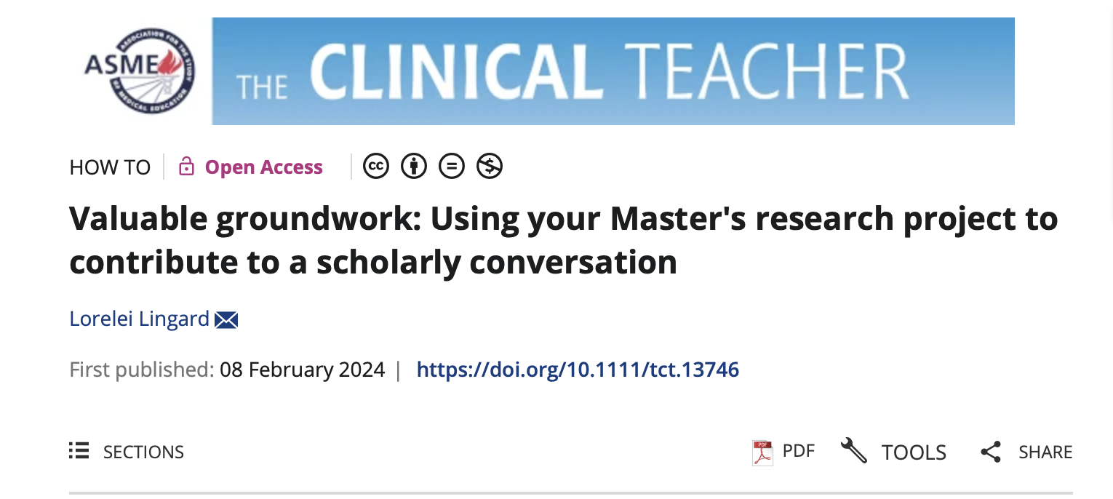

Slide 14
Subscription model
Journal costs met by subscription fees to publisher: individual or institution
Therefore, no payment for publication but paper will be behind a firewall
Readers need to pay to access the paper unless they have a subscription
Can choose to pay publication fee to make paper open access
This fee may be included in the institution’s subscription payment – need to check this
Copyright held by journal

Slide 15
Open access + pay to publish
Journals with open access charge once paper is accepted for publication
Fees vary and should be checked up-front
Open access papers are free to all readers – may lead to more views/citations
Usually, authors retain copyright; articles are available under a Creative Commons licence to allow free access, copy and use of research provided the author is correctly attributed.

Slide 16
Types of review process
Double-blinded – remove all identification
Single-blinded
Fully transparent

Slide 17
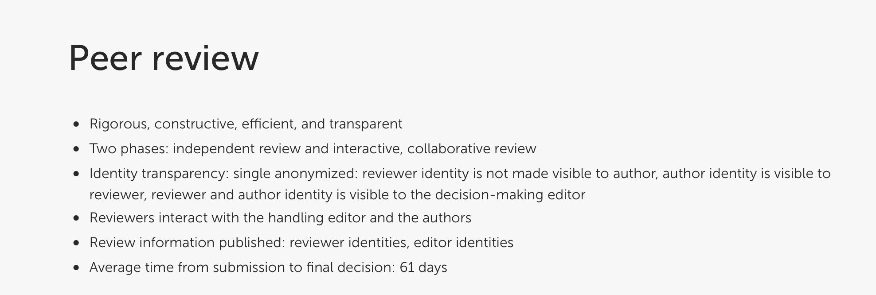
Frontiers group

Slide 18
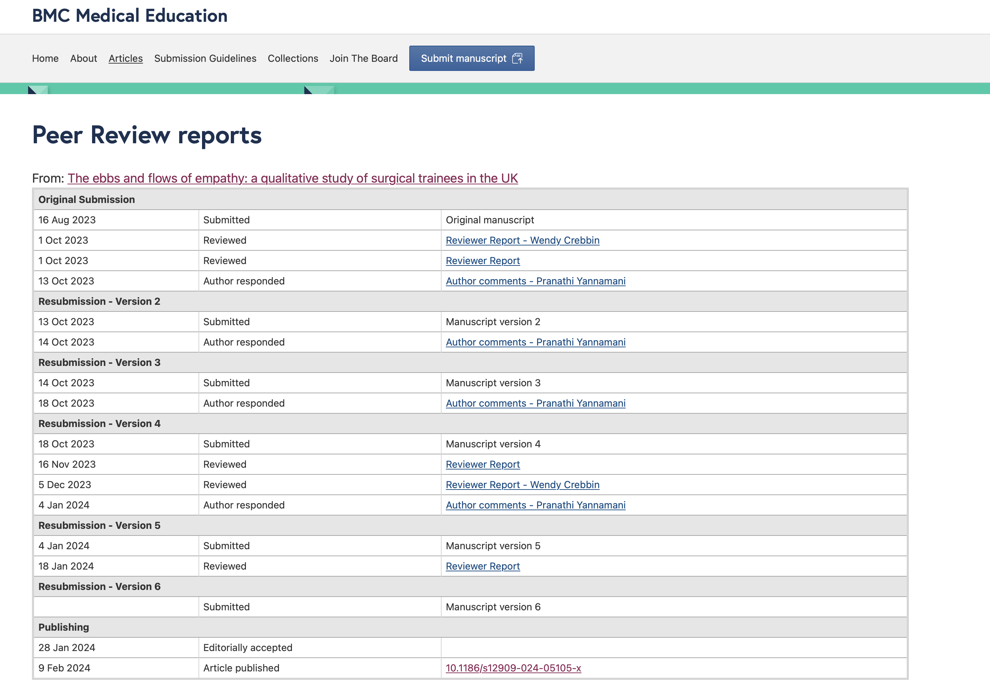

Slide 19
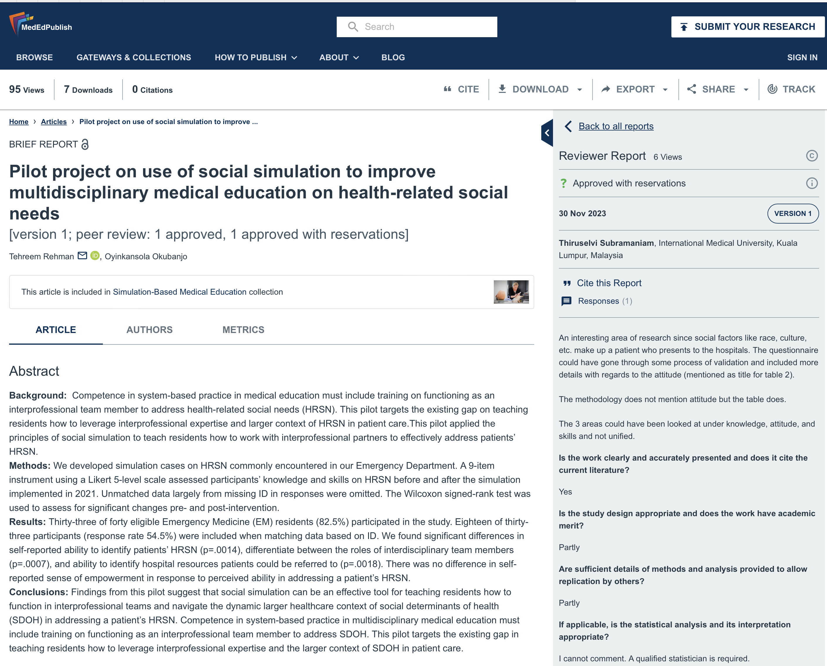

Slide 20
Consider
What makes a ‘good’ paper
What are editors looking for
What does the field need?

Slide 21
Khalili, H., Thistlethwaite, J., El-Awaisi, A., Pfeifle, A., Gilbert, J., Lising, D., MacMillan, K., Maxwell, B., Grymonpre, R., Rodrigues F., Snyman, S., Xyrichis, A. (2019). Guidance on Global Interprofessional Education and Collaborative Practice Research: Discussion Paper. A joint publication by InterprofessionalResearch.Global, & Interprofessional.Global. Retrieved from http://www.research.interprofessional.global

Slide 22
Proposed IPECP Research Priorities
Building the science and scholarship of IPECP through the discovery and integration of innovative evidence-informed strategies.
Identifying and applying innovative approaches that embrace and address the inherent complexity of interprofessional endeavours.
Developing evidence of impact along the continuum from interprofessional education to collaborative practice in person- and community-centred service delivery.

Slide 23
What editors/AEs look for
Clear message/argument: meaningful contribution to the field; informs contemporary debates
Transparent, rigorous & detailed methodology
Fully contextualised within existing literature; demonstrates current gaps in knowledge and how addresses these
Consistent use of terminology.
Strong, clear, evidence-based and forward-looking recommendations for scholars in field; implications; helps advance IPECP

Slide 24
‘Just not interesting to read!’
Read it all before
Writing not clear
Over-generalization
No obvious knowledge of prior work in the field
Small scale single institution study
Measuring attitudes and nothing else….
So what????

Slide 25
Typical reasons for JIC rejections
Not about interprofessional learning or practice: shared or common content
Clinical conditions – these belong in specific journals
One off atheoretical IPE events which have not been sustained and add nothing new to the literature
Work with a country specific focus and fails to offer wider international references/context to help the reader see the global significance

Slide 26
Is a Theoretical or Conceptual Framework needed?
It is critically important that the article provides sufficient background…There are a number of ways to describe this section – “conceptual framework”, “theoretical foundation”…
Advances in Health Sciences Education
The application of many of these theories is to help underpin the development of curricula or explain empirical findings from an interprofessional study.
JIC 2012

Slide 27
Main Challenges
More cross-sectional/multi-location
More longitudinal studies
Studies that articulate a theory of collaboration
Studies that show the benefits for patients/communities
Involving patient/community in research & education as partners

Slide 28
What’s happening
Pre-prints (authors’ original manuscript)
AI/chatGPT
Data repositories
Predatory publications
Paper mills
Fraud and retractions
Conflicts of interest

Slide 29
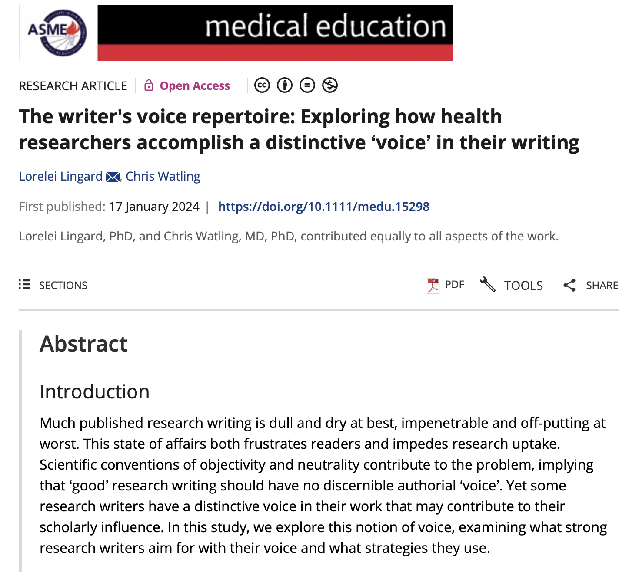

Slide 30
Upcoming events:
21 March: How do I... support research education and training for health professions students?
18 April: Masterclass - How do I... Create infographics to support teaching and research

Slide 31
Upcoming events:
20 June: Let's talk about... building collaborative teams in education and research

Slide 32
The next AIPPEN IPE Session:
AIPPEN IPE Session 2 TBA

Slide 33
Feedback Survey
https://forms.gle/ba9DhQ8E3EEXW3GHA

